Slide 1
Progress Report [ITSP]

Slide 2
Project Overview
Objective – Develop a stackable, flexible microfluidic system for high-throughput lipid nanoparticles (LNP production) bridging R&D and manufacturing gaps
Industry Need – Address HKPC’s challenge of inconsistent LNP properties due to discrepancies between R&D (microfluidics) and manufacturing methods (bulk mixing).

Slide 3
Literature Review
Need to conduct comprehensive review of LNP production methods:
Microfluidic Mixing – offers precise control of particle size and reproducibility.
Bulk Mixing – How industry scales and how this affect drug efficacy
Hybrid/Automated Bulk Micing – What are the emerging strategies to combine precision and scale.
Assessing microfluidic chip geometries
HFF, SHM, T-junction, Baffles and Bifurcation mixers
Identified some commercial platforms for scaling strategy
NanoAssemblr
insideTX Tamara

Slide 4
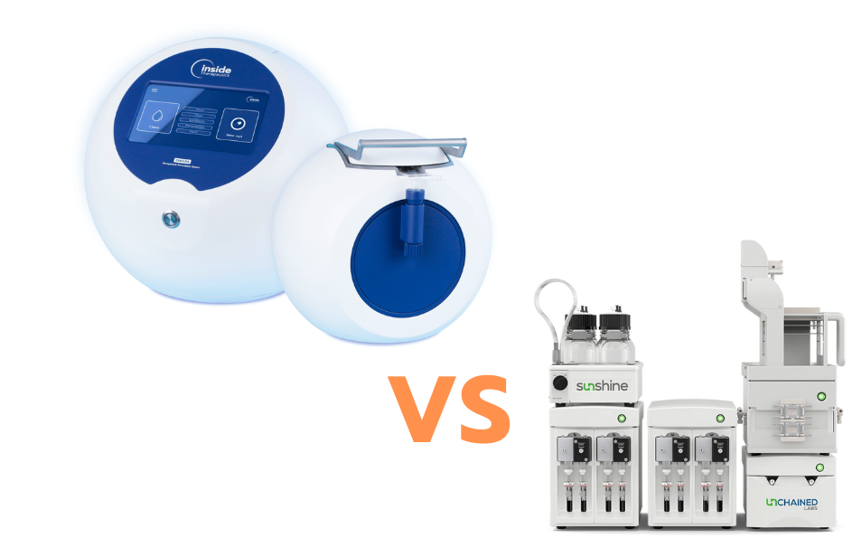
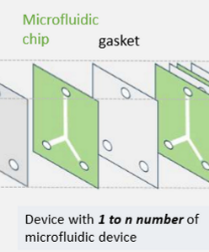
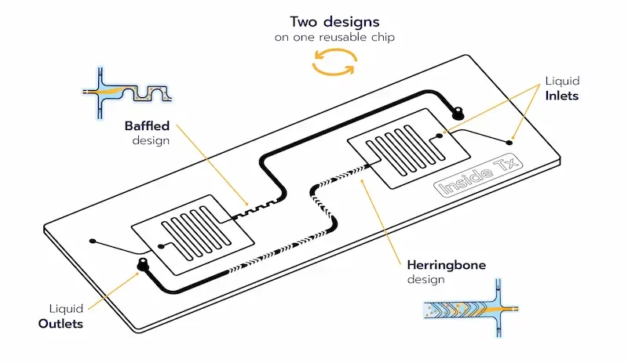
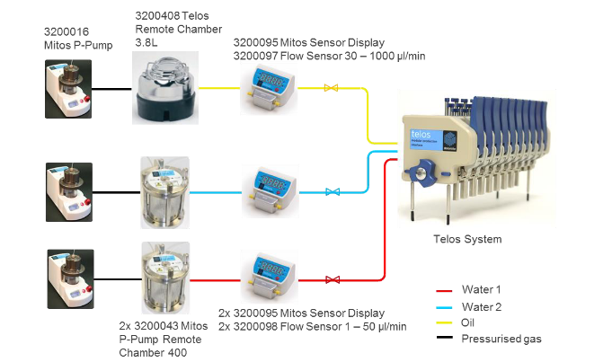
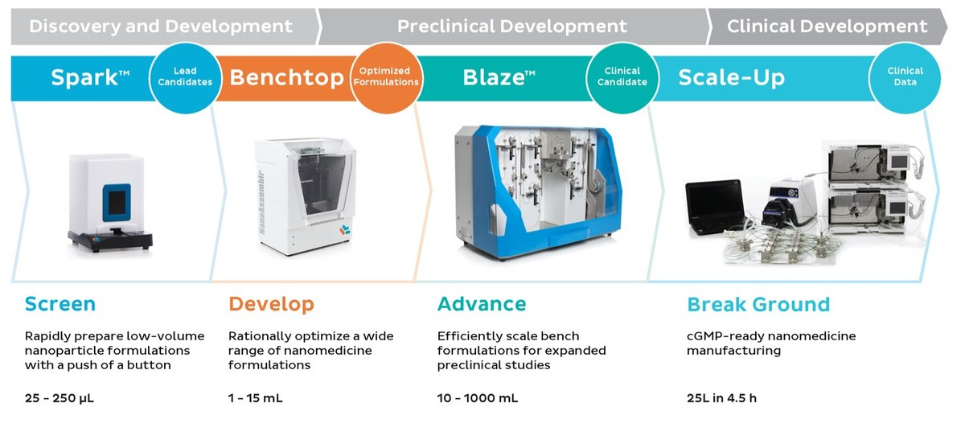
Design Concept
Automated flow control hardware
Multi Channel Mixing
Stacked Chip
Notes:
https://star-lab.am/upload/iblock/e10/qhzay9oczkvfv9gipyua7kurxjjyow87/508_dolomitemicrofluidics.pdf

Slide 5
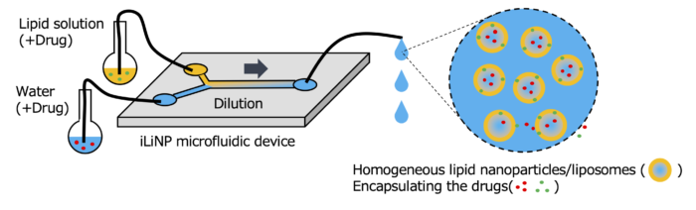
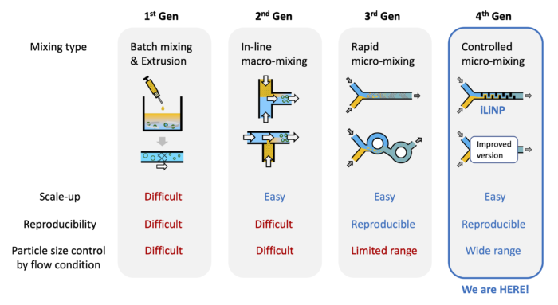
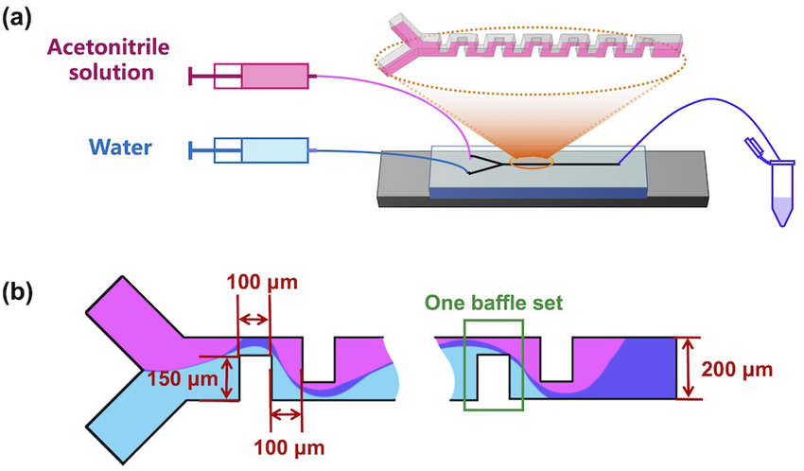
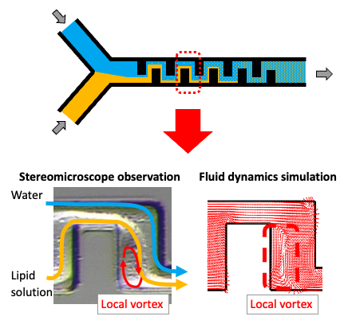
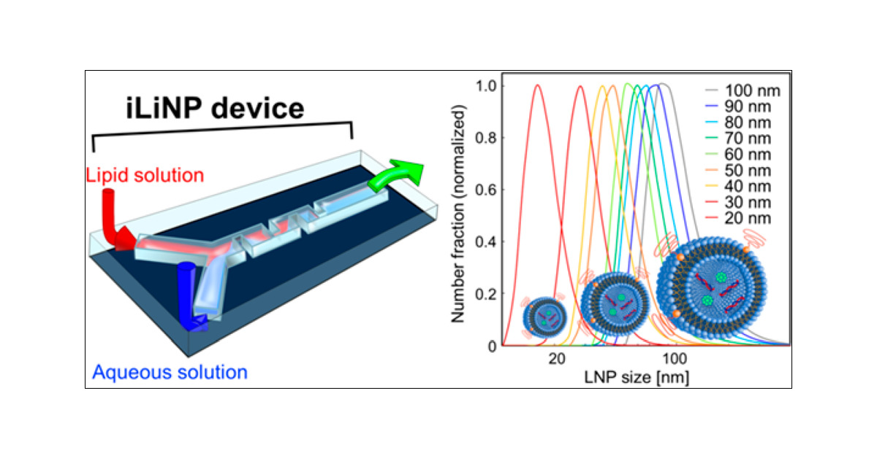
iLiNP

Slide 6
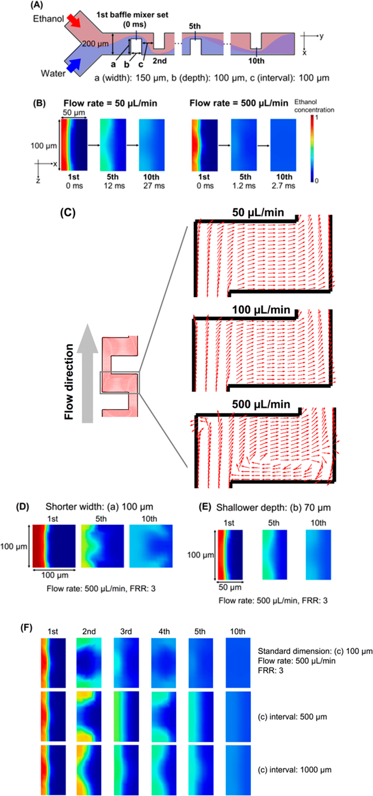
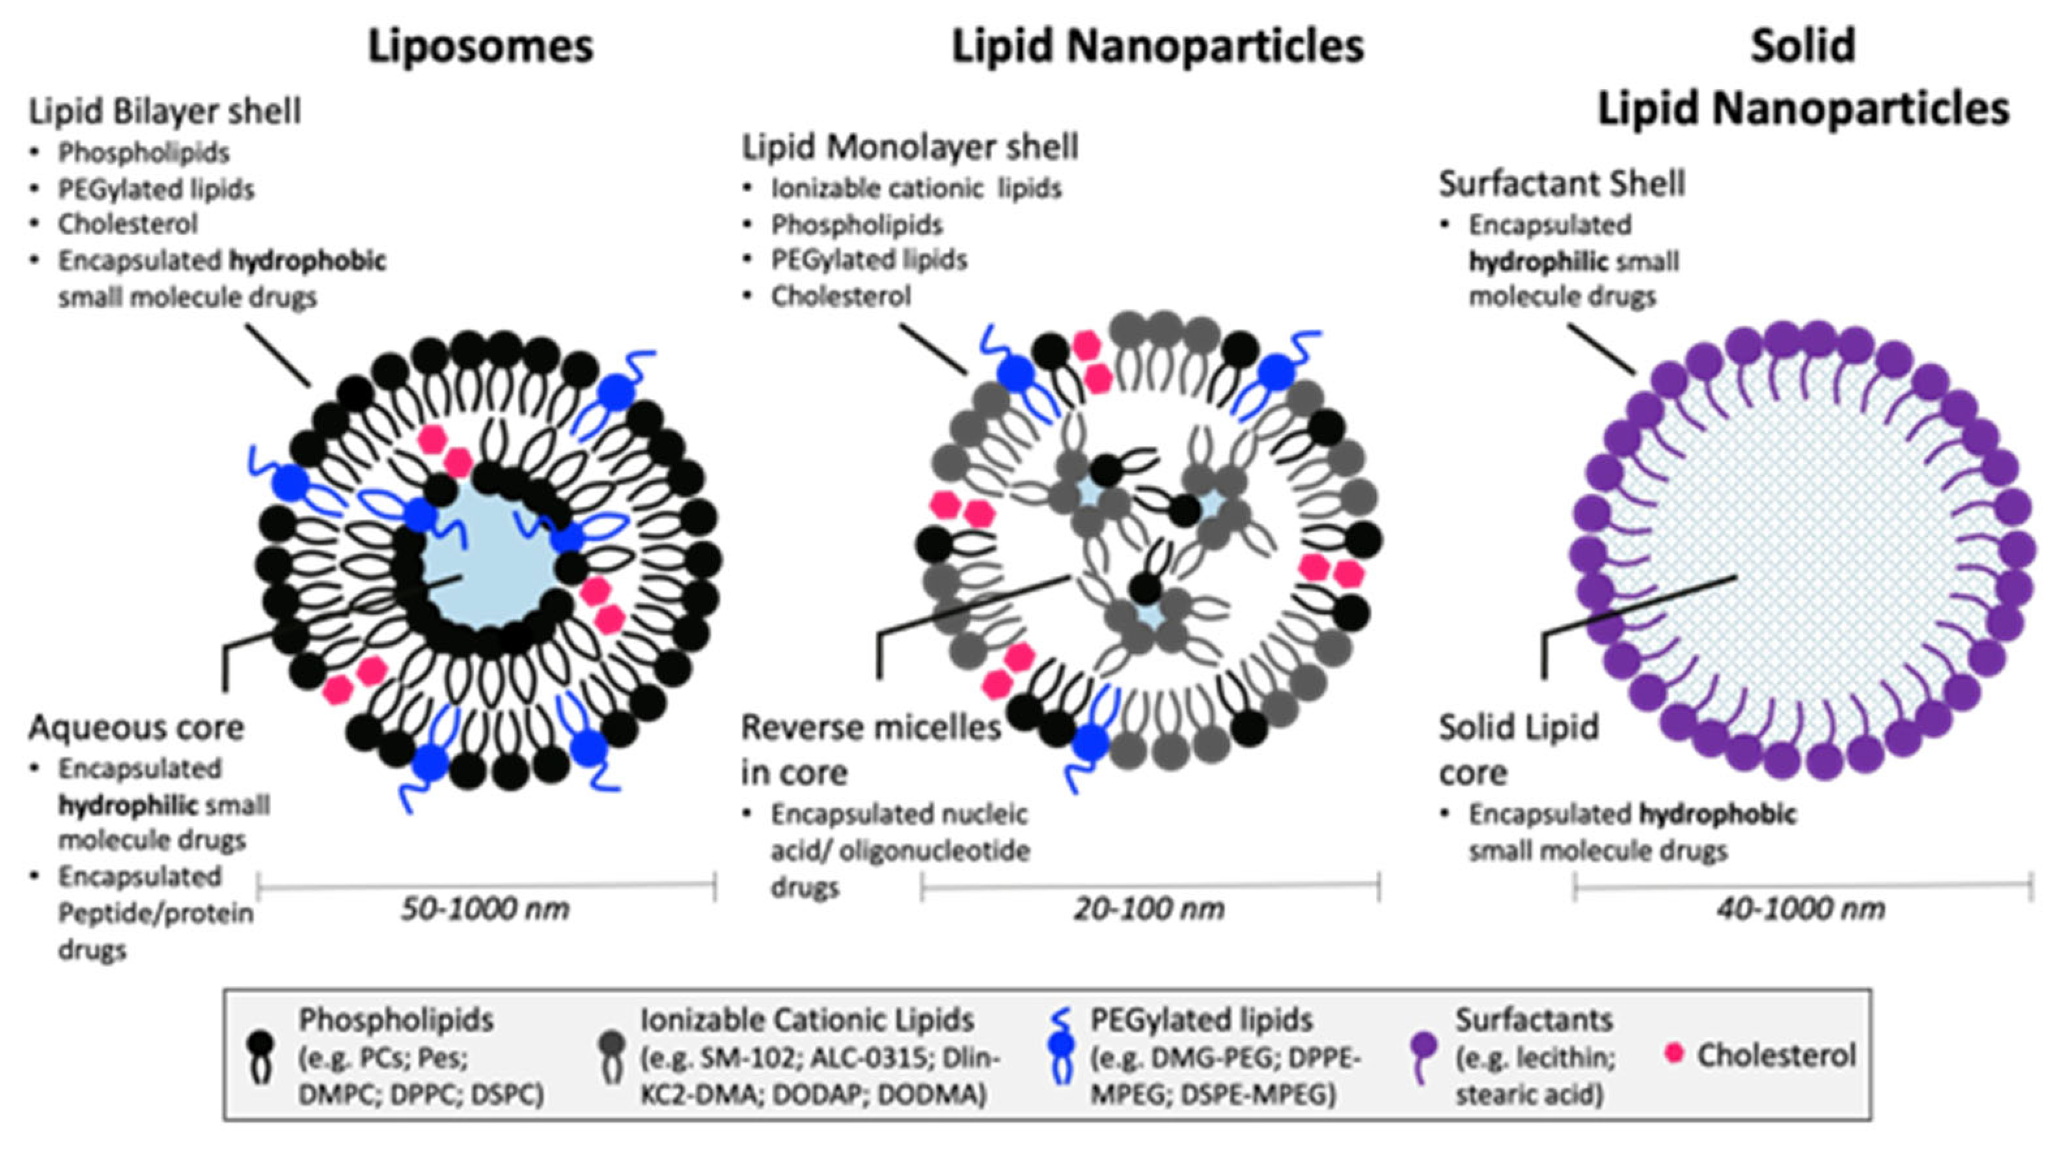
iLiNP

Slide 7
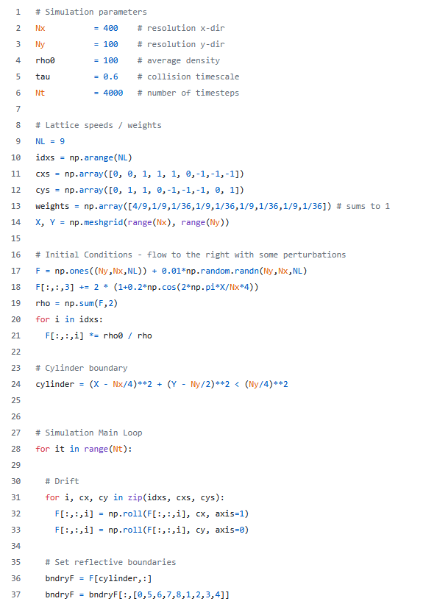

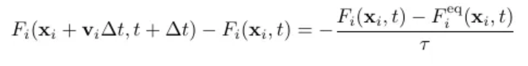
CFD
Not exactly sure how to use yet
Comparing different Mixing designs
Multi channel mixing for throughput

Slide 8
Questions
General system or specific NLP?
Development
Manufacturing few chips or ask City-U
Report
Literature review
2x scalable solution + Analysis with costs & timeline
Physical chip?
How was the microfluidic overview presentation?
Notes:
Concept for stackable devices … what pressure changes and flow rate when stacked?… what size LNP… stackable and slottable
City-U don’t recommend PDMS, recommended glass
Further info about the design under this scope
1.4 mn HK$ … 700k for R&D … advise whether this can be done or limit the scope … can be outsurced to external party
Comparison of 1 vs 10 chips (small number)
SIMPLE SOLUTION --- PROTOTYPING

